Slide 1
Binary to Gray Code Converter
Presented by:
Vaishali
Mahathi
Tridhama
Preetham
Digital Design and Computer Architecture
Notes:
Introduce the project: a combinational circuit that converts a binary number into Gray code using XOR gates, built and simulated in Logisim.

Slide 2
What is Gray Code?
Gray code (reflected binary code) is a number system in which two successive values differ in exactly one bit.
3-bit Gray sequence
0 000
1 001
2 011
3 010
4 110
5 111
6 101
7 100
1
One-bit change
Each step flips a single bit position.
2
Unweighted
Bit positions carry no fixed place value.
3
Cyclic
The last code differs from the first by one bit.
Amber = bit that changed
Notes:
Gray code was designed so that only one bit changes between consecutive numbers. In ordinary binary, 011 to 100 flips three bits at once, which can cause glitches in hardware.

Slide 3
Binary vs Gray Code
Decimal | Binary | Gray
0 | 0000 | 0000
1 | 0001 | 0001
2 | 0010 | 0011
3 | 0011 | 0010
4 | 0100 | 0110
5 | 0101 | 0111
6 | 0110 | 0101
7 | 0111 | 0100
Decimal | Binary | Gray
8 | 1000 | 1100
9 | 1001 | 1101
10 | 1010 | 1111
11 | 1011 | 1110
12 | 1100 | 1010
13 | 1101 | 1011
14 | 1110 | 1001
15 | 1111 | 1000
Gray = Binary XOR (Binary shifted right by 1)
Notes:
Walk down the Gray column: between any two consecutive rows exactly one bit changes. For example 0111 to 0101 to 0100.

Slide 4
Conversion Logic
XOR truth table
Copy the MSB
G3 = B3. The top bit is unchanged.
1
A | B | A ⊕ B
0 | 0 | 0
0 | 1 | 1
1 | 0 | 1
1 | 1 | 0
XOR neighbouring bits
Each remaining Gray bit = the binary bit XOR the bit to its left.
2
G3 = B3
G2 = B3 ⊕ B2
G1 = B2 ⊕ B1
G0 = B1 ⊕ B0
Read the result
G3 G2 G1 G0 is the 4-bit Gray code.
3
Notes:
The whole converter is three XOR gates. G3 is just a wire from B3. Every other Gray bit is the XOR of two adjacent binary bits.

Slide 5
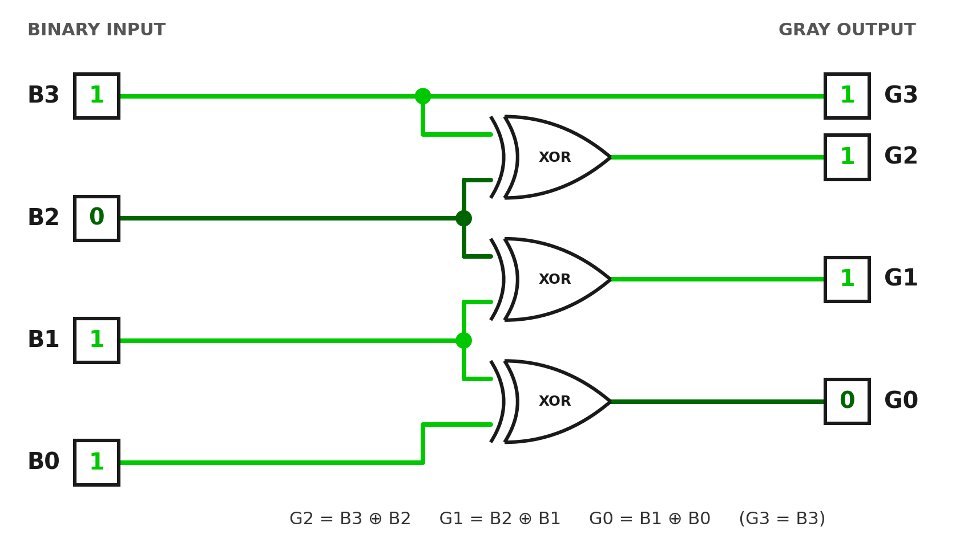
Circuit Design in Logisim
4
Input pins
B3 to B0
3
XOR gates
one per changing bit
4
Output pins
G3 to G0
Example: input 1011 gives output 1110
Notes:
Built in Logisim: place four input pins, three XOR gates and four output pins. B3 goes straight to G3. Wire B3,B2 into the first gate, B2,B1 into the second and B1,B0 into the third. Use Poke to toggle inputs and watch the outputs.

Slide 6
How It Works: 1011 to 1110
B3
B2
B1
B0
Binary input
1
0
1
1
XOR operation
copy
1 ⊕ 0
0 ⊕ 1
1 ⊕ 1
Gray output
1
1
1
0
G3
G2
G1
G0
Notes:
B3 = 1 is copied straight to G3. Then 1 XOR 0 = 1, 0 XOR 1 = 1, and 1 XOR 1 = 0. So 1011 in binary becomes 1110 in Gray code. XOR outputs 1 only when its two inputs differ.

Slide 7






Applications
Rotary Encoders
Karnaugh Maps
ADC and Comms
Avoids false readings while a shaft moves between positions.
Adjacent cells differ by one bit, easing logic simplification.
One-bit steps reduce glitches in converters and links.
Counters and FIFOs
Position Sensors
Genetic Algorithms
Safe pointer passing between clock domains.
Absolute angle reading on optical or magnetic discs.
Small gene changes cause small value changes.
Notes:
Rotary encoders are the classic example: with plain binary, a misaligned sensor could read a wildly wrong value at a transition. With Gray code the worst error is one step. The same property helps Karnaugh maps, ADCs and clock-domain crossing.

Slide 8
Thank You
Any questions?

